Slide 1
BAS B.V. // 23 January 2024 // AMERSFOORT

Slide 2
Information session Tranche 3
Programme Allocatie 2.0
Information session 2 – 23 January 2024

Slide 3








Welcome to the information session for Tranche 3 A2.0
Mute your microphone.
Turn off your camera.
Ask questions via the chat feature. We are working with a moderator.
Presentation on mijnMFFBAS.
The session is being recorded.
The session will be available for 4 weeks. E-mail projecten@mffbas.nl
Recording is taking place for interested parties, with your approval.
All questions and answers will be placed on mijnMFFBAS.

Slide 4
Tranche 3 - generic section
Go live 1 January 2025

Slide 5
Content and speakers
Subject generic information | Speaker
Welcome and planning | Mirjam van der Horst (chairman IISO, secretary PFSG)
Approved changes (RFC’s) New and changed documentation Transition of processes Frequently asked questions | Bram van Straalen (member IISO and team lead Messaging team)
Testing and transition | Jorik van Vilsteren (manager Testing and Transition)
Qualification TenneT | Gijsbert Steenaert (programme manager TenneT)
Qualification EDSN | Frans Willem Strabucchi (integration manager EDSN)
Information aimed at market role supplier
Processes with impact on market role supplier Consequences not ready on go-live date | Bram van Straalen (member IISO and notifications team)
Qualification suppliers on MMC-hub | Gijsbert Steenaert (programme manager TenneT)
Wrap-up | Mirjam van der Horst

Slide 6
Planning 2024
Mirjam van der Horst

Slide 7
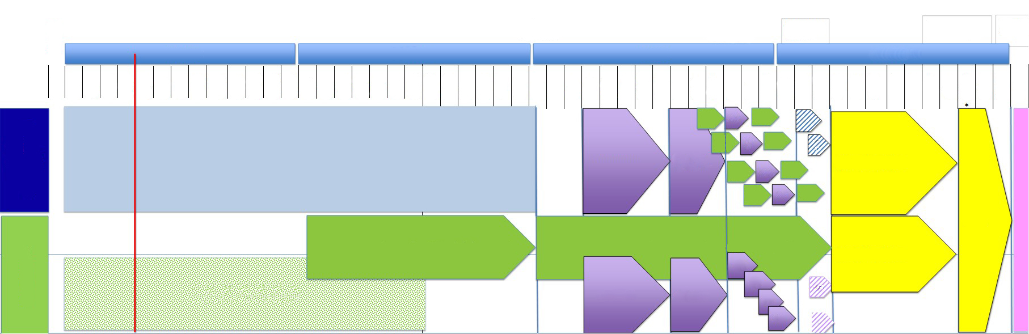
Milestone planning
T0
14
ok
T2'
3 July 2024
T2
16-9- 2024
GAT end 11-10-2024
Technical go live 14-12-2024
Functional go live 1-1-2
2024 Q1
2024 Q2
2024 Q3
2024 Q4
9 Oct
1 Jan
8 Jan
15 Jan
22 Jan
29 Jan
5 Feb
12 Feb
19 Feb
26 Feb
4 Mar
11 Mar
18 Mar
25 Mar
1 Apr
8 Apr
15 Apr
22 Apr
29 Apr
6 May
13 May
20 May
27 May
3 Jun
10 Jun
17 Jun
24 Jun
1 Jul
8 Jul
15 Jul
22 Jul
29 Jul
5 Aug
12 Aug
19 Aug
26 Aug
2 Sep
9 Sep
16 Sep
23 Sep
30 Sep
7 Oct
14 Oct
21 Oct
28 Oct
4 Nov
11 Nov
18 Nov
25 Nov
2 Dec
9 Dec
16 Dec
23 Dec
30 Dec
6 Jan
IC 275 IC257
IC187 IC279
IC280 Light (receipt) DSO
Qualification connect
GAT
PUD Qualif.
GAT
Qualification connect
GAT
PUD Qualif.
GAT
CONSTRUCTION AND INTERNAL TESTING
Summer recess
Lead group
Qualification connect
PUD Qualif.
Preparation Go Live
GAT
Qualification connect
GAT
PUD Qualif.
GoLive
MMC HUB TENNET
Suppliers TQF technical connection
Market parties TQF functional testing & qualification
Preparation Go Live
GAT
MMC-HUB (construction, internal testing)
Summer recess
Lead group
gat
GAT
GAT
GAT
GAT

Slide 8
Planning, important milestones 2024
Q2 2024 – qualification suppliers MMC-hub
T2’ 3 July – central building ready
3 July-26 August – summer recess; internal testing
26 August – start lead group tests
T2 start GAT – entry requirement successful connectivity test on testing environment MMC-hub and MES
25 October – end GAT
14 October – send market readiness: ready for go live?
6 November – last GMM go live, status acceptance criteria go live
29 November – decision point PFSG go live acceptance criteria met (66% per market role in scope)
2-14 December – no more RFC’s in system
13 December IISO – Go/No Go start deployment
14 December – technical go live
1 January 2025 – functional go live

Slide 9
RFC’s, documentation, transition of processes
Bram van Straalen

Slide 10
Requests for Change
Introduction

Slide 11
Overview RFC’s – since information session 1 on 12-09-2023
Scope and planning
RFC - A2.0-TR3-5 ‘Technical Go Live to 14 December 2024’
RFC-005-A2.0-TR3 ‘IC280L Scope change’
Contents
RFC-280L-1 ‘Receipt electricity per BRP-SUP’
RFC-003-A2.0-TR3 ‘Correction types in BS Settlement results’
RFC-006-A2.0-TR3 ‘New codes for volumes’

Slide 12
Requests for Change
Scope and planning

Slide 13
RFC A2.0-TR3-5
‘Bring technical Go live forward to 14-12-2024’
Cause | When revising the planning, it appeared that the technical go live could be brought forward by a week, and thus need not be in the first week of the Christmas holidays
Solution RFC | Bring technical go live forward from weekend 21-12-2024 to 14-12-2024
Impact | See the sheets concerning planning and milestones
Status | Approve*
* Also mentioned in the previous information session, but this RFC had not yet been approved at the time

Slide 14
RFC-005-A2.0-TR3
‘IC280L Scope change’
Cause | TenneT is unable to deliver IC280L on time for Tranche 3
Solution RFC | IC280L (EDINE notifications reconciliation PRF electricity) out of scope for Tranche 3* Modification of the receipt (also part IC280L) will remain in scope for Tranche 3 Modification BRS and business services
Impact | BRP: EDINE messages will continue to be used for reconciliation PRF electricity Receipt will be modified in Tranche 3 SUP (indirect): Receipt (“kassabon”) will be modified in Tranche 3 Distribution system operators: EDINE message will continue to be used for reconciliation PRF electricity Receipt will be modified in Tranche 3 TenneT: EDINE messages will continue to be used for reconciliation PRF electricity
Status | Approved The changes have already been incorporated into the BRS and the business services
* IC280L must be rescheduled again. The date is not yet known

Slide 15
Requests for Change
Contents

Slide 16
RFC IC280L-1
‘Receipt electricity per BRP-SUP’
Cause | In the business service ‘Exchange volumes for settlement and reconciliation electricity’, it is not clear enough that a separate receipt (“kassabon”) electricity must be supplied per grid area-BRP-SUP The name of the receipt (“kassabon”) must also be modified (must contain both the EAN code BRP and the EAN code SUP)
Solution RFC | Fine-tuning description so that receipt “kassabon” must be supplied per grid area-BRP-SUP in: business service ‘Exchange volumes for settlement and reconciliation electricity’ Change file name receipt (“kassabon”) in: business service ‘Generic File Exchange (GBU)’ business service ‘Exchange data sets’
Impact | DSO, BRP and SUP (see sheets presentation information session on 12-09-2023)
Status | Approved The changes have already been incorporated into the business service ‘Exchange volumes for settlement and reconciliation electricity’ Changes in the other business services will be completed at the end of 2024

Slide 17
RFC-003-A2.0-TR3
Correction types in BS Settlement results
Cause | A few inaccurate types have been mentioned under prices and amounts for imbalance settlement periods (IC257) in the business service ‘Exchange reconciliation results electricity’
Solution RFC | Correction types in the business service ‘Exchange reconciliation results electricity’
Impact | TenneT, BRP and SO
Status | Approved The changes have been incorporated into the concerned business service in the meantime

Slide 18
RFC-006-A2.0-TR3
‘New codes for volumes’
Cause | Various notifications containing one or more types of volumes are exchanged in Tranche 3, such as reconciliation volumes per month, reconciliation volumes per imbalance settlement period, grid loss mutations, etc. In order to recognise the types of volumes in notifications, the notifications contain codes which state the types of volume(s) within a notification In the current business, this has been done using international codes of ENTSO-E These ENTSO-E codes appear to have another meaning in other notifications (outside A2.0), which is not useful
Solution RFC | Use new (Netherlands-specific) codes for A2.0 Tranche 3 Incorporate these codes into the concerned business services
Impact | TenneT, BRP, SUP and SO
Status | Approved The changes have been incorporated into the concerned business services in the meantime

Slide 19
Changed documentation

Slide 20
Changed documentation since 12-09-2023
Reason for change
  Incorporation of various RFC’s (mentioned above).
  Incorporation of RFC A2.0-6 ‘Optimising checks measurement data’’ (was already part of scope for Tranche 3)
  After incorporating the above mentioned RFC’s
  BRS ‘Reconciliation data’* v2.0
  Business service ‘Exchange volumes for reconciliation* electricity’ v3.0
  Business service ‘Exchange reconciliation results* electricity’ v3.0
  Business service ‘Exchange collection-settlement request’ v3.0
  After incorporating RFC A2.0-6 ‘Optimising checks measurement data’
  Business service ‘Exchange measurement data time series’ v10.0
  Business Service ‘Exchange revision requests’ v6.0
  Business service ‘Exchange measurement data volumes and meter readings’ v6.0
  Business service ‘Exchange measurement data volumes installation’ v5.0
* The term settlement has been changed to reconciliation in all documentation, in order to be in line with the code change proposal and the draft MSP Wholesale Electricity.

Slide 21
BRS ‘Reconciliation data’ v2.0
Reason for changes | Use of the term ‘settlement’ instead of ‘reconciliation’ in code change proposal and MSP Wholesale Electricity RFC-005-A2.0-TR3 IC280L Scope change
Changes compared to previous version (global) | The term ‘settlement’ has been replaced by ‘reconciliation’ UC A20.303: use case changed UC A20.306: use case changed UC A20.313: use case changed
Impact on | TenneT, BRP, SUP and SO
Status | Approved in PFSG on 19-01-2024

Slide 22
Business service ‘Exchange volumes for reconciliation electricity’ v3.0
Reason for changes | Use of the term ‘settlement’ instead of ‘reconciliation’ in code change proposal and MSP Wholesale Electricity RFC-005-A2.0-TR3 ‘IC280L Scope change’ RFC 280L.1 ‘Receipt electricity per BRP-SUP’ RFC-006-A2.0-TR3 ‘New codes for volumes’
Changes compared to previous version (global) | The term ‘settlement’ has been replaced by ‘reconciliation’ All messages concerning IC280L with the exception of receipts have been removed (the chapter titles are still present)
Impact on | TenneT, BRP, SUP and SO
Status | Approved in PFSG on 19-01-2024

Slide 23
Business service ‘Exchange reconciliation results electricity’ v3.0
Reason for changes | Use of the term ‘settlement’ instead of ‘reconciliation’ in code change proposal and MSP Wholesale Electricity RFC-005-A2.0-TR3 ‘IC280L Scope change’ RFC 280L.1 ‘Receipt electricity per BRP-SUP’ RFC-003-A2.0-TR3 ‘Correction types in business service Settlement results’ RFC-006-A2.0-TR3 ‘New codes for volumes’
Changes compared to previous version (global) | The term ‘settlement’ has been replaced by ‘reconciliation‘ The codes for volumes have been modified All messages concerning IC280L have been removed (the chapter titles are still present)
Impact on | TenneT, BRP, SUP and SO
Status | Approved in PFSG on 19-01-2024

Slide 24
Business service ‘Exchange collection-settlement request’ v3.0
Reason for changes | Use of the term ‘settlement’ instead of ‘reconciliation‘ in code change proposal and MSP Wholesale Electricity RFC-006-A2.0-TR3 ‘New codes for volumes’
Changes compared to previous version (global) | The term ‘settlement’ has been replaced by ‘reconciliation‘ The codes for volumes have been modified
Impact on | SUP and SO
Status | Approved in PFSG on 19-01-2024

Slide 25
Transition
Introduction

Slide 26
Transition and times lines for processes Tranche 3
New/changed processes in Tranche 3 are ‘monthly processes‘
  IC257 and IC275: M+2 (provisional) and M+5 (definitive)
  IC252: M+1
Time lines from functional go live (FGL)
  IC257 Reconciliation TMT
  IC275 Reconciliation TMT
Use of IC011B, IC252, IC257 in relation to Tranche 3
  Phaseout IC011B
  Interfaces with IC257 and IC252
Transition RFC A2.0-6 ‘Optimising checks measurement data’
  Implementation date

Slide 27
Transition
Time lines IC257 and IC275

Slide 28
Time lines IC257 and IC275
Reconciliation TMT and SMA
The first reconciliation month that will be reconciled is January 2025 (2025.01)
M+2 (provisional) and M+5 (definitive)
The table below clarifies the time lines for the first reconciliation months
Actor | SO | TSO | SO | TSO | TSO
Data | Volumes for provisional reconciliation | Provisional reconciliation results | Volumes for definitive reconciliation | Definitive reconciliation results | Invoice
Reconciliation month | M+2 6th working day | M+2 11th working day | M+5 6th working day | M+5 11th working day | M+6 1st working day
2025.01 | 2025.03 |  | 2025.06 |  | 2025.07
2025.02 | 2025.04 |  | 2025.07 |  | 2025.08
2025.03 | 2025.05 |  | 2025.08 |  | 2025.09
2025.04 | 2025.06 |  | 2025.09 |  | 2025.10
Calculate month transition reading SMA
First notifications ‘volumes for reconciliation‘
First notifications ‘reconciliation results‘

Slide 29
Transition
IC011B/IC257/IC252

Slide 30
Underlying principles for transition
Metering notifications that are received before the functional go live (FGL = 01-01-2025) for Tranche 3 are processed in accordance with the existing processes
Metering notifications that are received after the functional go live (FGL = 01-01-2025) for Tranche 3, will be processed in accordance with the new processes; also if the measurement data relates to a period prior to the FGL
Moment that the metering notifications are sent by MRP will be the same as the moment of receipt by SO*
Settlements of grid interface points between system operators will remain 'as is' and (thus) bilateral
* In other words: it is assumed that the notifications are processed immediately and that there is no noteworthy processing time. This is the case for all notifications, excluding incidents

Slide 31
Telemetry electricity
START
Receipt metering notification for TMT allocation point (MSN N20; VSN N41)
Date metering notification received
>= FGL-TR3
Consumption period* is prior to FGL-TR-3
Ongoing IC011B case** concerning this consumption period?
End IC011B case
yes
yes
yes
no
no
no
Date metering notification received >=5 calendar months after consumption period?
Process in accordance with settlement process measurement errors GV (IC252)
(only VSN N41)
yes
* In terms of telemetry, the period must be entirely before (or after) the GL-TR3 date per definition. This can overlap for profiles, and it is relevant to use a start/end date for the period.
** Ongoing case = no definitive settlement request via IC011B for the same consumption period for a previously received correction.
FGL = functional go live
no
Process in accordance with reconciliation TMT (IC257)
Process in accordance with
IC011B

Slide 32
PRF Electricity (N40)
TMT & PRF Gas (N30; N60)
START
Receipt metering notification for Gas or Electricity PRF (MSN N30; VSN N30; N40)
Has the reconciliation period expired?
Date metering notification received
>= FGL-TR3
Process in accordance with settlement process measurement errors GV (IC252)
(only VSN N30 and N40)
yes
yes
no
no
Stop process. There is no process for settling this case between the market parties
FGL = functional go live
Handle in A&R process

Slide 33
Transition measures time lines (1)
IC011B / IC252
Provisional (M+3) and definitive (M+6) settlement proposals are exchanged between SO and BRP in the regular IC011B process
A one-off VVV will be issued in the M+1 between So and Sup via the future IC252 process
At the moment that transition measures were not being taken, these processes ran parallel for half a year, with the risk of disputes between the BRP, SUP and SO: which correction is settled via which process and with which market role?
Table A | IC011B |  | IC252
Process month | Provisional | Definitive | Send VVV
2024.07 | Oct 24 | Jan 25
2024.08 | Nov 24 | Feb 25
2024.09 | Dec 24 | Mar 25
2024.10 | Jan 25 | Apr 25
2024.11 | Feb 25 | May 25
2024.12 | Mar 25 | Jun 25
2025.01 |  |  | Feb 25
2025.02 |  |  | Mar 25
2025.03 |  |  | Apr 25
2025.04 |  |  | May 25
2025.05 |  |  | Jun 25
2025.06 |  |  | Jul 25

Slide 34
Transition measures time lines (2)
IC011B / IC252
  The time lines for IC011B will be temporarily modified so that the processes do not run parallel
X
Table B | IC011B |  | IC252
Process month | Provisional = definitive | Definitive = expired | Send VVV
2024.07 | Oct 24
2024.08 | Nov 24
2024.09 | Dec 24
2024.10 | Jan 25
2024.11 | Jan 25
2024.12 | Feb 25
2025.01 |  |  | Feb 25
2025.02 |  |  | Mar 25
2025.03 |  |  | Apr 25
2025.04 |  |  | May 25
2025.05 |  |  | Jun 25
2025.06 |  |  | Jul 25
Table A | IC011B |  | IC252
Process month | Provisional | Definitive | Send VVV
2024.07 | Oct 24 | Jan 25
2024.08 | Nov 24 | Feb 25
2024.09 | Dec 24 | Mar 25
2024.10 | Jan 25 | Apr 25
2024.11 | Feb 25 | May 25
2024.12 | Mar 25 | Jun 25
2025.01 |  |  | Feb 25
2025.02 |  |  | Mar 25
2025.03 |  |  | Apr 25
2025.04 |  |  | May 25
2025.05 |  |  | Jun 25
2025.06 |  |  | Jul 25
Time lines IC011B as of 01-07-2024

Slide 35
Terminology
FGL-TR3 = functional go-live date Tranche 3 (01-01-2025)
MSN = metering notification Measurement Series Notification (measurement data with a granularity of 15 minutes (ELK) or 60 minutes (GAS)
  MSN N20: Monthly quarter notification Electricity
  MSN N30: Monthly hour notification Gas
VSN = metering notification Volume Series Notification (measurement data with a granularity of minimum 1 day)
  VSN N30: Volume Gas PRF
  VSN N40: Volume Electricity PRF
  VSN N41: Volume Electricity TMT
VVV = collection-settlement request
IC011b = ‘Settlement allocation errors’
IC252 = ‘Settlement process measurement errors GV’
IC257 = ‘Reconciliation GV Telemetry Electricity’

Slide 36
Transition
RFC A2.0-6 ‘Optimising checks measurement data’

Slide 37
Transition RFC A2.0-6 ‘Optimising checks measurement data’
Metering notifications that are sent as of the functional go live (FGL = 01-01-2025) for Tranche 3 are compiled and validated in accordance with this RFC
  The new Product-ID for kWmax 8716867000016 will be used in notifications that are sent as of 01-01-2025
  The modified checks will be used in notifications that are received as of 01-01-2025
Therefore, metering notifications will be compiled and validated in accordance with the existing business service between the technical go live (TGL = 14-12-2024) and the functional go live (FGL = 01-01-2025)

Slide 38
Tests and transition
Jorik van Vilsteren

Slide 39
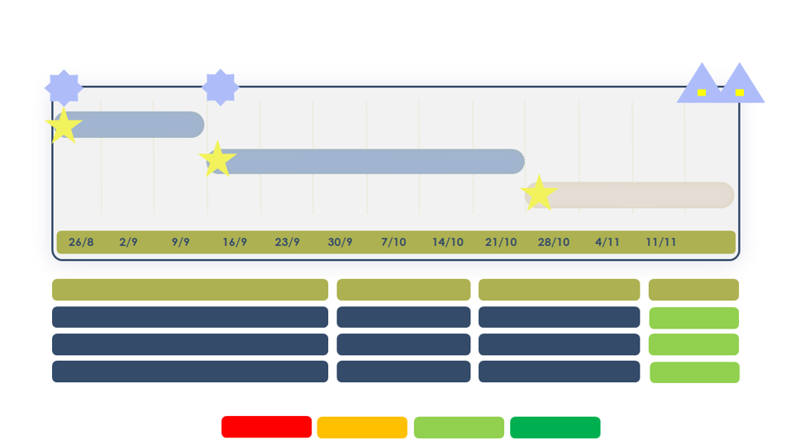
Tests - planning
Master test plan is currently being reviewed by the Lead group; it will be made available via mijnMFFBAS after approval
Milestone planning with Status Report
T2'
T2
TGL
FGL
M
1
Lead group Test (KT)
M
2
User Acceptance Test (GAT)
M
3
Transition
Project Milestones
Date Ready
Owner
Status
M1 – Start Lead group (KT)
26 August
IISO
Not yet started
M2 – Start User Acceptance Test (GAT)
16 September
IISO
Not yet started
M3 – Start Transition
28 October
IISO
Not yet started
Legend =
Too late
Delayed
In accordance with planning
Ready

Slide 40
Tests – Lead group
Detailed test plan Lead group will be available in Q1-2024
Planning: 26-08-2024 – start progression and regression tests, completion 13-09-2024
The participants are: Request – we are still urgently searching for:
SUP: Essent and Eneco SUP large consumption = already resolved by Eneco
BRP: none! 2 BRP’s!!
MRP: Kenter MRP
DSO: All DSO’s FGO/CDSO
TSO-E: TenneT
FGO/CDSO: Kenter
Register by sending an e-mail to vragen@mffbas.nl or by contacting Jorik van Vilsteren directly ((+31) (0)6 1294 7218)

Slide 41
Tests – GAT (User Acceptance Tests)
Detailed test plan GAT will be available in Q1-2024
Planning: 16-09-2024 – start progression and regression tests, completion 25-10-2024
We will be testing in three groups. A successful connectivity test with the TQF environment of MMC-hub is a prerequisite for participating in the GAT. Contact TenneT about this!
Experience has shown that, due to a variety of reasons, market parties mainly want to test in the last group, which presents the risk of delays. BAS hereby urgently asks all market parties to take into account a start date of 16-09-2024
Should you nonetheless have an urgent reason to start the GAT at a later time, please mention this via vragen@mffbas.nl
The provisional and definitive groups for the GAT will be announced around 1 April via the MFFBAS newsletter
Start group 1: 16-09-2024, Start group 2: 23-09-2024, Start group 3: 30-09-2024

Slide 42
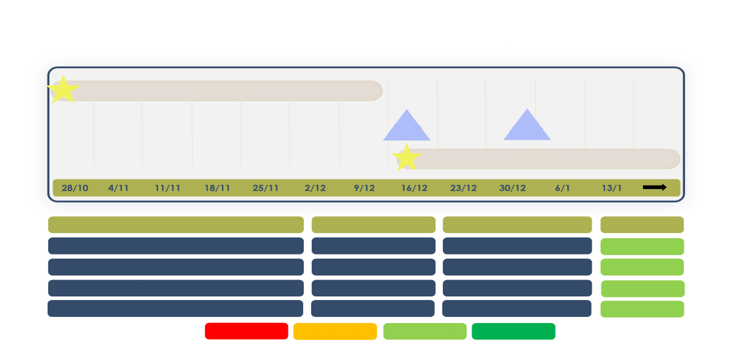
Transition – planning
Transition plan is currently being reviewed by the project team; it will be made available via mijnMFFBAS after review and approval IISO
Milestone planning with Status Report
M
3
Transition
TGL 14-12
FGL 1-1
M
4
After care
Project Milestones
Date Ready
Owner
Status
M3 – Start Transition
23 October
IISO
Not yet deposited
TGL – Technical Go Live
14 December
IISO
Not yet started
FGL – Functional Go Live
1 January
IISO
Not yet started
M4 – After care
1 May
IISO
Not yet started
Legend =
Too late
Delayed
In accordance
with planning
Ready

Slide 43
Transition – Consultation group
Generic Transition plan will be available in Q1-2024
Planning: 28-10-2024 – start transition and after-care, completion 01-05-2025
KBG Transition will meet 1x per month as of 01-01-2024 to discuss current topics
The participants are:
SUP: Eneco
BRP: PVNED
MRP: Kenter
DSO: all DSO’s
TSO-E: TenneT
TSO-G: GTS
FGO/CDSO: Kenter
Interested? Register by sending an e-mail to vragen@mffbas.nl or by contacting Jorik van Vilsteren directly ((+31) (0)6 1294 7218)

Slide 44
Transition – deliverables
Document | Planning
Sector transition plan | Q1-2024
Fall-back plan | Q1-2024
PCE Document | Q2-2024
Implementation scenarios | Q2-2024
Transition ledger | Q3-2024
After-care plan | Q3-2024
Transition report | Q4-2024
Progress report (incl. qualification) | Continuous process

Slide 45
Qualification TenneT
Gijsbert Steenaert

Slide 46
Market-Market-Communication Hub
Fast (re)introduction
Market party
Non-repudiation/message signing
Market party
Carrier
MMC-hub
Carrier
Transport
security
Transport
security
XML message
Push
Pull
Confirmation
TenneT is a regular market party for the MMC-hub

Slide 47
MMC-hub
More information:
TenneT Web Services Guide on MyTenneT
Tranche 3 connectivity info will be published in mid-February
Fast (re)introduction
Market party
Market party
Synchronous
MMC-hub
Synchronous
XML message
Syntax validation
Syntax OK
XML message
Syntax validation
Technical confirmation (SOAP)
Technical confirmation (SOAP)
Syntax OK
Outbox
Asynchronous
(NACK)
Header check
(such as: idempotency)
(NACK)
Signing check
Back-office
Policies
Semantic validation
ACK / NACK

Slide 48
Test and Qualification Facility (TQF)
Testing with other party or fully autonomously
Parties can test freely against the TQF: initially, but also to test later changes on the party's side before the go live
TenneT will use TQF to offer the semantic validations to be carried out by each market role
TQF will soon support relevant scenarios that can be used for testing and qualification
The TQF app on MyTenneT will offer a user interface and self-service functionalities on TQF
MyTenneT
TQF app
Market party
TQF environment
MMC-hub (copy)
Semantic validations
BRP validations
(BSP validations)
Other market party
DSO validations
TSO validations
(MRP validations)
(……. Validations)
Q module
Scenario 1
Scenario 2
Scenario 3
Scenario n

Slide 49
Planning
Tip for SO, BRP and MRP:
Check whether you can still access the TQF environment, deliver renewed questionnaire and certificates if necessary
Parallel flows
TenneT Test and Qualification plan will be published at end Q1
Intended qualification requirement suppliers: only qualify for applicable portfolio
(KV and/or GV)
Completion of qualification is not a requirement for participating in the MFFBAS GAT, but connectivity with TQF is necessary
Parties can primarily test and qualify autonomously
Basic test support is only provided after registration (time slots), on a full = full basis
2024Q1
2024Q2
2024Q3
2024Q4
2025Q1
TenneT back-end
Settlement price determination
Robustness TQF
Market role simulation
Test scenarios
Suppliers TQF technical connection
1. Q-SOs
Prepare
Market parties TQF functional tests & qualification
Lead group
GAT
2. Q-BRPs & T-MRPs
Go Live
3. Q-SUPs
SUP support
Test support and qualification
After care
In accordance with Net code 13.33:
‘Users of the central communication system are only permitted to exchange notifications if the users in question possess a test certificate, which has been issued by the system operator of the national high-voltage grid, for every exchanged notification. The certificate is valid for a maximum of 12 months.‘

Slide 50
Acceptance plan suppliers
A timely start will help to avoid a lot of stress
Now: pre-registration via TenneTCCC@tennet.eu
March: fill in questionnaire and supply certificates (MyTenneT)
Q2: realise connectivity with MMC-hub on TQF
Q3/Q4: functional tests and qualification
01-01-2025: go live!
Access to MyTenneT
You will be able to access MyTenneT after pre-registration. All registered SUPs will have access as soon as documentation is available (mid-February)

Slide 51
Action plan SO, BRP and MRP
A timely start will help to avoid a lot of stress
In time for June: check for access to the TQF environment, action if needed
June: fill in questionnaire and possibly supply certificates (MyTenneT)
Q3: functional tests and qualification
01-01-2025: go live!
Opening registrations
At the end of May, SO’s, BPR’s and MRP’s will be invited to start the testing and qualification process

Slide 52
Focus points
Market parties can test and qualify autonomously, but TenneT must take care of configuration on the MMC-hub. This will take place on a first come first serve basis.
Once you have completed the various qualification scenarios, you must inform TenneT about the Correlation ID’s of the concerned tests. Qualification will be approved after a check has been carried out
Support by TenneT employees is basic, but enough to effectively complete testing and qualification, for instance:
  Configuration and installation certificates
  Continuous improvement of documentation and FAQ’s based on questions from market parties
  Basic support for debugging the interface and referral to the appropriate FAQ
Support is only provided after registration for support time slots

Slide 53
Qualification EDSN
Frans Willem Strabucchi

Slide 54
Qualification collection-settlement request notification (VVV)
IC252
Qualification concerning VVV for SUP, TSO, CDSO

Slide 55
IC252: qualification market parties concerning collection-settlement request exchange
Many market parties have to qualify for the newly introduced VVV notifications. Strict agreements are needed to make sure that this process flows smoothly:
  All parties that want to use the new automated notification flows via MES (Message Exchange Service – successor of PUD: Portal Exchange Service) must qualify for this with EDSN
  This involves three logical steps that parties can actually carry out one after the other:
    Prior to GAT: MES connectivity check
    Times GAT: go through GAT test scenarios
    Following-on from GAT: VVV qualification
At the start of Q3 2024, EDSN will supply a VVV qualification plan that includes the qualification scenarios:
  The plan will be shared with qualifying market parties via MFFBAS
  EDSN will help parties during qualification, however, only once parties have completed connectivity and the GAT
  To ensure an effective flow, the parties will be divided equally in four GAT groups, with an agreed time slot within which the three steps must be carried out

Slide 56
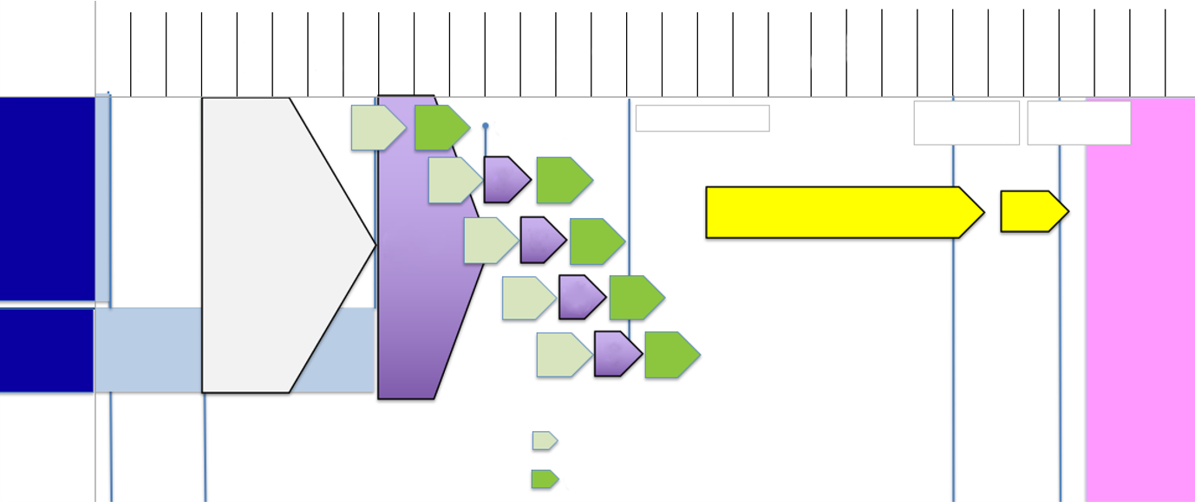
Tranche 3 test & acceptance planning
15 Jul
22 Jul
29 Jul
5 Aug
12 Aug
19 Aug
26 Aug
2 Sep
9 Sep
16 Sep
23 Sep
30 Sep
7 Oct
14 Oct
21 Oct
28 Oct
4 Nov
11 Nov
18 Nov
25 Nov
2 Dec
9 Dec
16 Dec
23 Dec
30 Dec
6 Jan
13 Jan
20 Jan
27 Jan
1 Jul
8 Jul
vvv-cc
vvv
Qualification
T2 = 16 Sept.
End GAT = 11 Oct.
Techn. Go Live 14 Dec. 2024
Funct. Go Live 1 Jan. 2025
IC 275 IC257 IC187 IC279 IC280 Light
vvv-cc
GAT
TR3
vvv
Qualification
Preparation Go Live
Go Live
Summer recess
Lead group
Test
vvv-cc
GAT
TR3
vvv
Qualification
After care
vvv-cc
GAT
TR3
vvv
Qualification
IC252
vvv-cc
GAT
TR3
vvv
Qualification
T2' = 23 Aug.
VVV-CC: VVV Connectivity Check
VVV-KW: VVV Qualification

Slide 57
Tranche 3 – suppliers
Go live 1 January 2025

Slide 58
Processes with impact on suppliers and consequences not ready on go live date
Bram van Straalen

Slide 59
Tranche 3 – extra information for suppliers
Tranche 3 has impact on market role supplier
  Various messages via the MMC-hub (new channel for the supplier)
    Connection
    Qualification
  Settlement measurement errors (IC252)
That is why there is an extra information session with impact for suppliers:
  Processes
  Messages
  Important timely connectivity and qualification MMC-hub and PUD

Slide 60
Tranche 3 – new and changed processes

Slide 61
Tranche 1 and 2 – summary
Tranche 1 (TR2021)
  Metering notification GV (IC249)
    Distinction between consumption and production (no offsetting)
    From EDINE to XML
  Objection metering notifications GV (IC248)
    Process modifications (responsibility objection)
    From EDINE to XML
Tranche 2
  Allocation
    Interim solution profile allocation (IC273)
    Distinction between consumption and production (IC273 and IC276)
    From EDINE to XML (IC273 and IC276)
  Metering Correction Report 2.0 (IC253)

Slide 62
Tranche 3 – introduction
Definitive imbalance determination on 10th working day after a calendar month
  Difference between forecast/nomination of BRP with allocation volumes
  Will be settled using an imbalance price
(New) measurement data may be available after definitive imbalance determination
  This offsetting is referred to as settlement or reconciliation*
  Depending on type of allocation point:
    Granularity measurement data (per OVP, per month or a longer period)
    Timeliness measurement data (if available)
Tranche 3 focuses on new/modified reconciliation processes
  Specified as issues per type of allocation point (allocation group)
* The term ‘settlement’ is not used in the draft code-change proposal and draft MSP WE, and we will no longer be using it in other documents and in this presentation

Slide 63
Overview issues
ELK/GAS | KV/GV | All. group | Reconciliation | Settlement measurement errors after reconciliation
ELK | KV | SMA | IC275 Reconciliation SMA ELK | N/A
ELK | KV | PRF | IC280 L Reconciliation notifications PRF ELK to XML | IC011c
ELK | GV | PRF | IC280 L | IC252 Settlement process measurement errors GV GAS and ELK
ELK | GV | TMT | IC 257 Reconciliation TMT ELK | IC252
GAS | GV | PRF | Reconciliation gas
GAS | GV | TMT | Reconciliation gas
Gas | KV | PRF | Reconciliation gas
IC279 Reconciliation prices
IC187 Retention period Metering data GV

Slide 64
Concise overview per issue

Slide 65

Does the issue have impact on?
Large consumers | No
Small consumers | Yes
Electricity | Yes
Gas | No
DSO | Yes
TSO | Yes
SUP | Yes
MRP | No
BRP | Yes
Codes | Yes
Messages | Yes
Chain processes | Yes
Privacy | Yes
Is the issue release dependent/independent and what is the entry date of the issue?
Release dependent | Yes
Release independent
IC275
Settlement SMA

Slide 66
IC275 Reconciliation SMA - Overview
Metering data | Monthly volumes based on month-transition readings
Period | Reconciliation per calendar month = reconciliation month (month M)
Frequency | M+2 = provisional M+5 = definitive
To be settled volumes | Difference between sum allocation volumes (per OVP) and monthly volumes
Responsibilities | DSO: supply monthly volumes SO: TSO (TenneT): calculation volume differences
Prices | Monthly prices (without differentiation by tariff period)
Settlement | Between TSO (TenneT) and the BRP

Slide 67
IC275 Reconciliation SMA – process flow
DSO
Calculate missing month-transition readings + monthly volumes per allocation point
Aggregate
per NG-BRP-SUP
Aggregate
per NG-BRP
M+2
Reconciliation results
per NG-BRP
M+5
TenneT
M+2
M+5
Monthly volumes
per NG-BRP
Calculate reconciliation results
(volume differences + amounts)
M+2
M+5
BRP
Monthly volumes
per NG-BRP-SUP
Reconciliation results
per BRP
M+2
Reconciliation results
per NG-BRP
M+2
M+5
M+5
SUP
Determined readings and volumes*
per allocation point
Monthly volumes
per NG-BRP-SUP
M+5
* Regular data exchange beyond reconciliation SMA

Slide 68
IC275 Reconciliation SMA – example per grid area per BRP
Allocation volume per OVP
 | Allocation volumes |  | Monthly volumes
Period | Consumption | Production | Consumption | Production
Calendar day 1, OVP 1 | 100 | 5 | - | -
Calendar day 1, OVP 2 | 105 | 4 | - | -
…. | … | … | - | -
Calendar day 31, OVP 95 | 108 | 2 | - | -
Calendar day 31, OVP 96 | 101 | 3 | - | -
∑ Definitive allocation | 1488246 | 378890 | - | -
Monthly volumes | - | - | 1495789 | 381271
Difference | - | - | 7543 | 2381
Sum of monthly volumes from all allocation points for that BRP in the concerned grid area
Sum of all allocation volumes in the concerned reconciliation month
Settlement with month price

Slide 69
IC275 Reconciliation SMA - sector documentation
Issue document
IC275 ‘Reconciliation SMA’ v1.0, 18-10-2022
Business Requirement Specification (BRS)
BRS ‘Reconciliation’ v2.0, 19-01-2024
Business service (BS)
Business service ‘Exchange volumes for reconciliation electricity’ v3.0, 19-01-2024 BSCMF0081–‘ Exchange aggregated volumes for reconciliation per grid area’ Business service ‘Exchange reconciliation results electricity’ v3.0, 19-01-2024 BSCMF0087– ‘Exchange reconciliation results for aggregated volumes’

Slide 70

Does the issue have impact on..?
Large consumers | Yes
Small consumers | No
Electricity | Yes
Gas | No
DSO | Yes
CDS Owner | Yes
TSO | Yes
SUP | Yes
MRP | Yes
BRP | Yes
Codes | Yes Net code
Messages | Yes
Chain processes | Yes
Privacy | Yes
Is the issue release dependent/independent and what is the entry date of the issue?
Release dependent | Yes
Release independent | No
IC257
Settlement GV Telemetry Electricity

Slide 71
IC257 Reconciliation TMT – overview*
Metering data | New OVP volumes (versus OVP volumes used in allocation) Monthly volumes (volume measured across the whole month)
Period | Reconciliation per calendar month = reconciliation month (month M)
Frequency | M+2 = provisional M+5 = definitive
To be settled volumes | Difference between allocation volumes and OVP volumes (volume difference per OVP) Difference between sum OVP volumes and monthly volumes (volume difference per month)
Responsibilities | SO: supply OVP volumes and monthly volumes TSO (TenneT): calculation volume differences
Prices | Prices per OVP Monthly prices (without differentiation by tariff period)
Settlement | Between TSO (TenneT) and the BRP
* Replaces IC011B

Slide 72
IC257 Reconciliation TMT – process flow
SO
Determine volumes per allocation point
Aggregate
per NG-BRP-SUP
Aggregate
per NG-BRP
M+2
Reconciliation results
per NG-BRP
M+5
TenneT
M+2
M+5
Monthly volumes + OVP volumes
per NG-BRP
Calculate reconciliation results
(volume differences + amounts)
M+2
M+5
BRP
Monthly volumes + OVP volumes
per allocation point
Monthly volumes + OVP volumes
per NG-BRP-SUP
Reconciliation results
per BRP
M+2
Reconciliation results
per NG-BRP
M+2
M+2
M+5
M+5
M+5
SUP
Monthly volumes
per allocation point
Monthly volumes
NG-BRP-SUP
M+5
M+5

Slide 73
IC257 Reconciliation TMT – example per grid area per BRP
Volume for reconciliation per OVP per energy direction
Settlement with OVP price
Allocation volume per OVP per energy direction
 | Allocation volume |  | Volumes for reconciliation |  | Difference
Period | Consumption | Production | Consumption | Production | Consumption | Production
Calendar day 1, OVP 1 | 100 | 5 | 102 | 6 | 2 | -1
Calendar day 1, OVP 2 | 105 | 4 | 104 | 10 | -1 | 6
…. | - | - | - | - | - | -
Calendar day 31, OVP 95 | 108 | 2 | 115 | 3 | 7 | 1
Calendar day 31, OVP 96 | 101 | 3 | 99 | 2 | -2 | -1
∑ Volumes per OVP |  |  | 1488246 | 378890
Monthly volume | - | - | 1495789 | 381271
Difference (per month) | - | - |  |  | 7543 | 2381
Sum of all reconciliation volumes OVP in the concerned settlement month
Settlement with month price
Monthly volume in the concerned reconciliation month

Slide 74
IC257 Reconciliation TMT – sector documentation
Issue document (IC)
IC257 ‘Settlement TMT’ v1.0, 18-10-2022
Business Requirement Specification (BRS)
BRS ‘Reconciliation data’ v2.0, 19-01-2024
Business service (BS)
Business service ‘Exchange volumes for reconciliation electricity’ v3.0, 19-01-2024 BSCMF0081 - Exchange aggregated volumes for reconciliation per grid area BSCMF0082 - Exchange volumes for reconciliation per individual allocation point BSCMF0083 - Exchange aggregated OVP volumes for reconciliation per grid area BSCMF0084 - Exchange OVP volumes for reconciliation per individual allocation point Business service ‘Exchange reconciliation results electricity’ v3.0, 19-01-2024 BSCMF0087 - Exchange reconciliation results and reconciliation results for aggregated volumes BSCMF0088 - Exchange reconciliation results for aggregated OVP volumes

Slide 75
IC280 L Reconciliation notifications PRF to XML
Modification receipt
  Changed content
  Receipt per grid area-BRP-SUP
Continues to be distributed from the DSO to the BRP

Slide 76
IC280 L – sector documentation
Issue document
N/A
Business Requirement Specification (BRS)
BRS ‘Reconciliation data’ v2.0, 19-01-2024
Business service (BS)
Business service ‘Exchange volumes for reconciliation electricity’ v3.0, 19-01-2024 BSCMF0086 - Exchange allocated volumes and determined volumes for reconciliation per individual allocation point* Business service ‘Exchange reconciliation results electricity’ v3.0, 19-01-2024 BSCMF0087 - Exchange reconciliation results for aggregated volumes
* No XSD, because exchange CSV via GBU/UD

Slide 77

Electricity and gas
 | Does the issue have impact on..?
Large consumers | Yes
Small consumers | No
Electricity | Yes
Gas | Yes
DSO/CDSO | Yes
TSO-E | Yes
SUP | Yes
MRP | Yes
BRP | Yes
Codes | Information code
Messages | Yes
Chain processes | Yes
Privacy | Yes
Is the issue release dependent/independent and what is the entry date of the issue?
Release dependent | Yes
Release independent | No
IC252
Settlement process measurement errors GV
Number | IC252 | Author(s) | Emiel Zandvliet
Date | 13-01-2023 |  | Joost Neuteboom
Version | 2.0
Status | Approved by SSG

Slide 78
IC252 Settlement process measurement errors GV – overview
Metering data | Monthly volumes or annual volumes (following measurement error) after reconciliation
Period | Settlement per calendar month (month M)
Frequency | Monthly
To be settled volumes | Difference with last notification with measurement data After reconciliation
Responsibilities | SO: supply monthly volumes/annual volumes and volume differences SO: calculation volume differences
Prices | Month prices
Settlement | Between SO and the SUP
No role for BRP and TenneT

Slide 79
IC252 Settlement process measurement errors GV – process flow
Determine settlements
per allocation point
Collect settlements
per product type
Answer
SO
Invoice*
SUP
Collection-settlement request
per product type
Evaluate collection-settlement request
* The party that is the net recipient for the collection-settlement report sends the invoice to the counter party. The invoice is subject to a lower limit of €50

Slide 80
IC252 Settlement process measurement errors GV – sector documentation
Issue document
IC252 Settlement process measurement errors GV’ v2.0, 13-01-2023
Business Requirement Specification (BRS)
BRS ‘Reconciliation data’ v2.0, 19-01-2024
Business service (BS)
Business service ‘Exchange collection-settlement request’ v3.0, 19-01-2024 BSCMF0090 - Exchange collection-settlement request

Slide 81

Does the issue have impact on..?
Large consumers | X
Small consumers | X
Electricity | X
Gas
DSO | X
TSO | X
SUP | X
MRP
BRP | X
Codes | Net code Electricity
Messages | X
Chain processes | X
Privacy
Is the issue release dependent/independent and what is the entry date of the issue?
Release dependent | X
Release independent
IC279
Settlement Prices

Slide 82
IC279 Reconciliation prices
Three (new) types of reconciliation prices are distinguished:
  Reconciliation price OVP
  Reconciliation price per month without tariff period
  Reconciliation price per month per tariff period (normal and low)
Allocation group | Issue | Reconciliation price
KV SMA | IC275 | Month price without tariff period
GV TMT | IC257 | OVP price (OVP volume) Month price without tariff period (monthly volumes)
KV PRF and GV PRF | IC280L | Month price per tariff period
GV | IC252 | Month price without tariff period

Slide 83
IC279 Reconciliation prices
Issue document
IC279 ‘Settlement prices’, v1.0, 18-10-2022
Business Requirement Specification (BRS)
BRS ‘Reconciliation data’ v2.0, 19-01-2024
Business service (BS)
Being carried out. Will be completed in Q1 2024

Slide 84
Impact on the market role SUP

Slide 85
Introduction impact on market roles
Component Tranche 3 | This describes the component of Tranche 3 that has an impact on the market role A separate table has been created per component The aim was to provide the most comprehensive overview possible per market role
Process and system impact * | This describes the process and system impact that must be structurally incorporated as a result of Tranche 3
Transition impact * | This describes the impact that only applies to the implementation of Tranche 3. This is thus one-off impact concerning the implementation of Tranche 3
* This is a general estimate for the impact on market roles and the first step to having the actual impact for an individual market party determined by the concerned market party itself!

Slide 86
IC275 ‘Reconciliation SMA’

Slide 87
IC275 – Month-transition readings SMA
Component Tranche 3 | For the new reconciliation process SMA, the DSO will calculate month-transition readings if they cannot be read from the smart meter The DSO will distribute the meter readings and consumption to the SUP via the regular processes
Process and system impact | Distribution by DSO is a regular process via existing notifications. Month-transition reading calculated by DSO
Transition impact | The first month-transition where this process starts is the functional go-live date for Tranche 3
Impact on | SUP

Slide 88
IC275 – volumes for reconciliation SMA
Component Tranche 3 | The DSO determines the aggregated volumes per calendar month based on the determined (monthly) volumes The DSO makes the aggregated volumes available to the SUP on M+5 per BRP/SUP
Process and system impact | Design process to receive these aggregated volumes via the MMC-hub Connect/qualify MMC-hub Implementation new notifications in accordance with: Business service ‘Exchange volumes for reconciliation electricity’
Transition impact | N/A
Impact on | SUP

Slide 89
IC275 – Reconciliation results SMA
Component Tranche 3 | TenneT supplies the reconciliation results (volume differences + amounts) that will be settled by TenneT to the BRP These reconciliation results (per calendar month per grid area and national) will be supplied to the BRP via the MMC-hub
Process and system impact | Settlement of reconciliation results between BRP and SUP (not a market process) Coordinate operational details with the BRP
Transition impact | N/A
Impact on | SUP

Slide 90
IC257 ‘Reconciliation TMT’

Slide 91
IC257 – volumes Reconciliation TMT
Component Tranche 3 | The SO supplies the volumes that will be reconciled by TenneT per allocation point to the SUP on M+5
Process and system impact | Connect/qualify MMC-hub Design process to receive and process these volumes Implementation new notifications in accordance with: Business service ‘Exchange volumes for reconciliation electricity’
Transition impact | N/A
Impact on | SUP

Slide 92
IC257 – Reconciliation results TMT
Component Tranche 3 | TenneT supplies the reconciliation results (volume differences + amounts) to the BRP. The reconciliation results per imbalance settlement period and per calendar month are determined each calendar month. These reconciliation results (per grid area and national) will be supplied to the BRP via the MMC-hub.
Process and system impact | Settlement of reconciliation results between BRP and SUP (not a market process). Coordinate operational details with the BRP.
Transition impact | N/A
Impact on | SUP

Slide 93
IC252 ‘Settlement process measurement errors GV’

Slide 94
IC252 – settlement measurement errors GV
Component Tranche 3 | Corrected metering data after measurement errors are encountered by MRP, and after the reconciliation period has passed, are settled between SO and SUP via this process The SO compiles a collection-settlement request each month, which contains all to be settled corrections (per product type electricity/gas) per process month The SUP checks this collection-settlement request After approval, the claiming party bills the total amount of the collection-settlement request
Process and system impact | Design process to receive and process the collection-settlement requests Implementation new notifications in accordance with: Business service ‘Exchange Collection-settlement Request’ Connect with PUD for this notification Design billing process based on definitive collection-settlement requests
Transition impact | N/A
Impact on | SUP

Slide 95
IC279 ‘Reconciliation prices’

Slide 96
IC279 – reconciliation prices
Component Tranche 3 | TenneT will calculate and publish new/modified reconciliation processes on its website
Process and system impact | Design process to receive and process reconciliation prices for calculation-settlement requests in accordance with: Business service ‘Reconciliation prices’ (will be published in Q1 2024)
Transition impact | N/A
Impact on | SUP

Slide 97
IC280L ‘Reconciliation PRF’

Slide 98
IC280L – reconciliation volumes PRF
Component Tranche 3 | The receipt remains with a slightly modified content, and is compiled per BRP/SUP
Process and system impact | The DSO continues to supply the receipt to the BRP via the existing channels
Transition impact | N/A
Impact on | SUP

Slide 99
Importance timely connectivity and qualification

Slide 100
Timely connectivity and qualification
MMC-hub
First notification exchange with MMC-hub TenneT for suppliers
Realising connectivity takes time (experience shows)
Timely start (of support possibilities TenneT) is limited
Late connection and qualification means:
  Receiving notifications about reconciliation SMA and TMT too late
  No/limited data for checking invoice from BRP
  No/limited data for determining ‘start point‘ calculating measurement errors GV (IC252)

Slide 101
Timely connectivity and qualification
MES
Late connection and qualification means:
  Late receipt and checks on notifications concerning collection-settlement requests
  Failure to respond to a collection-settlement request on time means ‘agreement with the collection-settlement request’

Slide 102
Qualification suppliers on MMC-hub
Gijsbert Steenaert

Slide 103
Deep dive TenneT
MMC-hub and onboarding process

Slide 104

Welcome to TenneT!
Pre-registration is possible via the TenneT Customer Care Center: tennetccc@tennet.eu
Timely registration ensures that you will allow us to reach you effectively using the correct contact details
After registration, you will be able to access MyTenneT (from mid-February), where all the ins and outs about the MMC-hub and the TQF can be found
Registration form for Market role for Supplier
Undersigned,
Name organization (Statutory name):
Registration number at Chamber of Commerce:
Statutory address, city & country:
Postal address / PO Box, city & country:
Visiting address, city & country:
EAN-code(s): (Global location number, 13-digits) as registered at EDSN in the role of supplier and at GS1.

Slide 105
MMC-hub further explained

Slide 106
My first MMC-hub account
This is where we left off …
Market party
Market party
Synchronous
MMC-hub
Synchronous
XML message
Syntax validation
Syntax OK
XML message
Syntax validation
Technical confirmation (SOAP)
Technical confirmation (SOAP)
Syntax OK
Outbox
Asynchronous
(NACK)
Header check
(such as: idempotency)
(NACK)
Signing check
Back-office
Policies
Semantic validation
ACK / NACK

Slide 107
Secure communication
At transport and notification level
Market party
Market party
Non-repudiation/message signing
MMC-hub
Transport
security
Transport
security
Transport certificates (TLS 1.3) are used to ensure safe and encrypted transport of information, whereby we ensure that only the involved parties are able to access the content of notifications. Transport security will be established between the market party (i.e. the carrier) and the MMC-hub using two-way recognition
Signing certificates are used for non-repudiation purposes, which shows that the notification travelled from the sender to the recipient without being changed. Signing security is end-2-end

Slide 108
MMC-hub header
Clear addressing for traceable exchange
Header
TechnicalMessageID – technical identification for this specific notification
CorrelationID – identification that establishes a link to the original notification (example: functional notification featuring the ACK)
SenderID – EAN code for the legal owner and thus signatory (signing) of the notification
ReceiverID – EAN code for the receiving party
CarrierID – EAN code for the ‘courier’ responsible for exchanging the notification
ContentType – prescribed indicator for the content of the notification, so that 1 notification type can be used and returned for several (sub)processes
The WS-security signing fixes the body of the notification, so that it cannot be altered during the exchange. However, it must be possible to alter the header: TechnicalMessageID & possibly the CarrierID
MessageAddressing
TechnicalMessageID
CorrelationID
SenderID
ReceiverID
CarrierID
ContentType
WS-security
CertificateAuthority
CertificateNumber
Body
Functional message

Slide 109
Notifications delivered by MMC-hub
Push mechanism
The push mechanism immediately offers notifications received on the MMC-hub to the web service of the receiving party
The receiving party can choose a different web service address per Content Type (in the header)
Push will have been successful if there is a correct SOAP reply
Retry mechanism if SOAP reply is not received
If necessary, the notification can also be temporarily pulled from the MMC-hub
MMC-hub
Market party
Push
Pull

Slide 110
Retrieving notifications from the MMC-hub
Pull mechanism
Should the receiving party decide to use this option, the notification can be readied for sending in the Outbox
Collection will take place using the signing certificate of the receiving party, to make sure that only the rightful party receives the notification
Collection starts with a LIST request, whereby a list is provided of ready but not-yet-collected notifications
A GET message can then be used to collect the notifications. Notifications that have already been collected will also remain temporarily available
Pull is unsuitable for very large volumes
MMC-hub
Market party
Push
Pull

Slide 111
Outsourcing exchange of notifications
Using a carrier
Market party
Message signing
Parties can contract a carrier to facilitate their notification exchanges
The Carrier will use its own transport security to establish communication with the MMC-hub
The market party will remain responsible for its notifications at all times. Notifications must thus also be signed using the signing certificate of the market party
Carriers must register as such with TenneT
Carrier
MMC-hub
Transport security and encryption
Message
ACK

Slide 112


Validations and response notifications
 | MMC-hub (synchronous) |  | Receiving party (asynchronous)
 | Technical validation |  | Functional validation
 | XSD check | Feedback | Header check | Feedback | Signing validation | Feedback | Semantic validation | Feedback
Market notification |  | Positive SOAP notification |  |  |  |  |  | Positive ACK
 |  | Negative SOAP notification |  | Negative ACK |  | Negative ACK |  | Negative ACK
Response notification |  | Positive SOAP notification
 |  | Negative SOAP notification
LIST / GET |  | Positive SOAP notification
 |  | Negative SOAP notification
A response notification is not followed by a new response
For a LIST or a GET, the MMC-hub also validates the signing during the synchronous call

Slide 113
Onboarding at TenneT

Slide 114
Regular transition milestones
Milestones for each project and each individual party
TenneT realisation
Onboarding and transition process
1. Prepare
  Process preparation
  Channel preparation
  Notification development
2. Connection
  Questionnaire
  Transport- & Signing Security
  Realise connection with Test & Qualification Facility (TQF)
3. Testing
  Functional testing (semantic validations)
  Test scenarios (processes)
4. Qualification
  Qualification in accordance with Net code as prerequisite for go live
5. Go live
  Realise connection with MMC-hub
  Go live
  Transfer to management
6. Operational
  Intensified surveillance
0. Publication of transition planning
0. Release of new market documentation
TenneT systems ready:
start transition
Market party is ready for onboarding
Market party has working connection with TQF
Market party has completed testing and debugging
Qualification
successful to participate in exchange of notifications
IT connection is operational and managed

Slide 115
Step 1: prepare
1. Prepare
Internal realisation at market party
TenneT realisation
Onboarding and transition process
1. Prepare
  Process preparation
  Channel preparation
  Notification development
2. Connection
  Questionnaire
  Transport- & Signing Security
  Realise connection with Test & Qualification Facility (TQF)
3. Testing
  Functional testing (semantic validations)
  Test scenarios (processes)
4. Qualification
  Qualification in accordance with Net code as prerequisite for go live
5. Go live
  Realise connection with MMC-hub
  Go live
  Transfer to management
6. Operational
  Intensified surveillance
0. Publication of transition planning
0. Release of new market documentation
TenneT systems ready:
start transition
Market party is ready for onboarding
Market party has working connection with TQF
Market party has completed testing and debugging
Qualification
successful to participate in exchange of notifications
IT connection is operational and managed

Slide 116
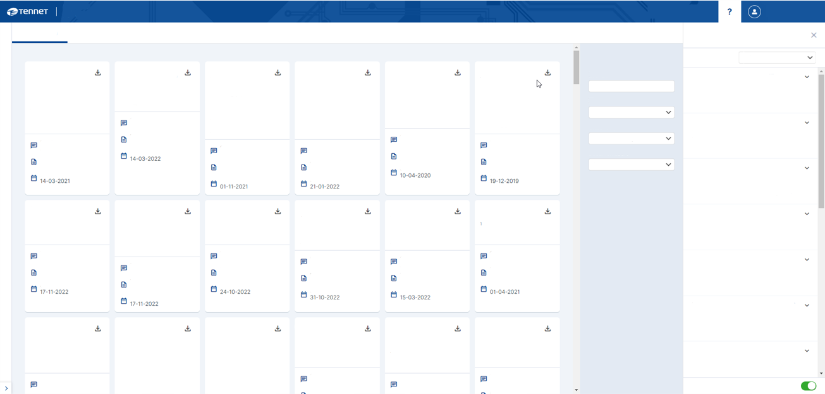
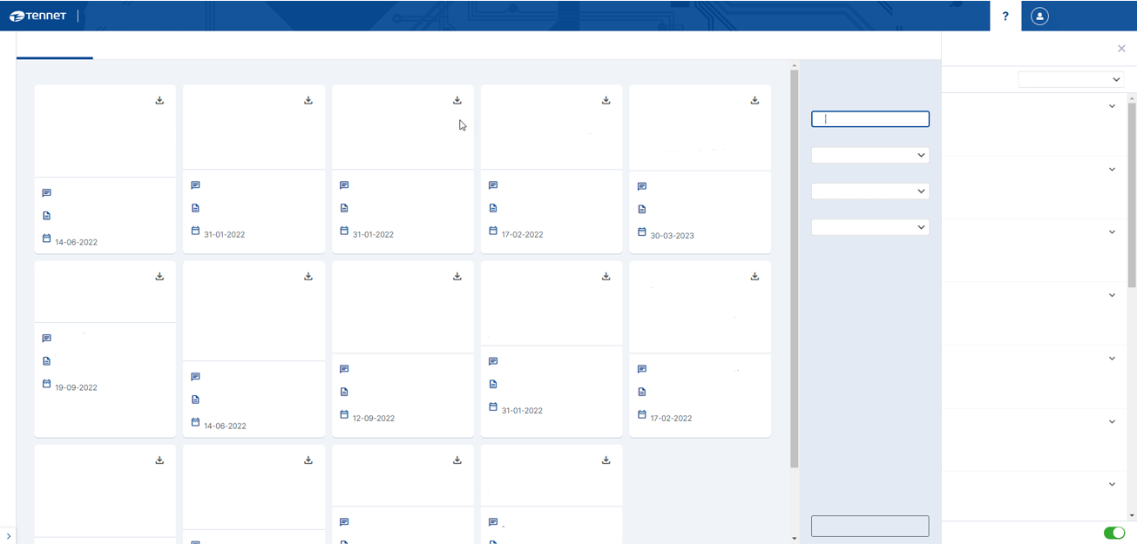

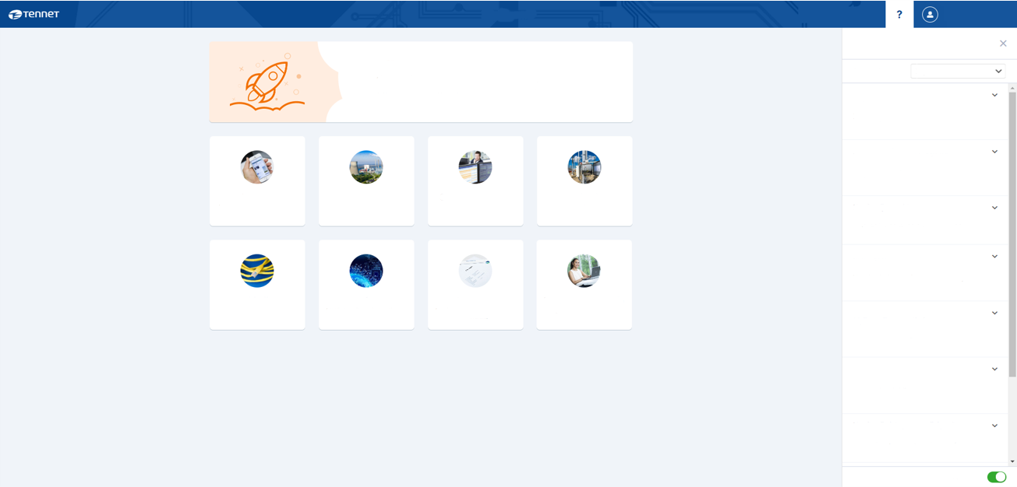
Preparation for communication with MMC-hub
1. Prepare
All relevant documentation found on MyTenneT
MyTenneT
MyTenneT
IT connections
IT connections
MyTenneT
Documents
Documents
MMC-hub certificates
MMC-hub certificates
Frequently asked questions
Frequently asked questions
Safer login MyTenneT
Frequently asked questions
Filters
Documents
Filters
Documents
Category
IT Connections
Category
IT Connections
AllocationSeries-wsdl-v1.0
Cyber security is given the highest priority at TenneT. That is why MyTenneT will soon be switching to a new 2-factor authentication method via the MobilePASS+ app instead of SMS. You will also soon be switching to the new authentication method. More information and instructions will follow via e-mail.
Bulk_Set_PROD_SigningCertificates_All_Market_Parties_For_Allocation2.0_Tranche2_Go
Category
MyTenneT
AllocationFactorSeries-wsdl-v1.0
AllocationVolumeRevision-
wsdl-v2.1
AggregatedAllocationSeries-wsdl
aFRR NL on CBP -Implementation Guide
aFRR Reserve Bid -
Semantical
Validations
Ancillary Service domain - wsdl
aFRR Reserve Bid -Implementation Guide
aFRR Reserve Bid -Technical Guide
Ancillaryservices-
reservebid-wsdl
Search
Search
What must I do if a certificate on the CPS needs to be renewed?
What must I do if a certificate on the CPS needs to be renewed?
1.1
WDSL containing
sendAggregatedAllocationFactorSeriesNotification,
sendAggregatedAllocationFactorSeriesAcknowledgement and IsAlive to check availability of web service for sending market documents.
1.0
1.0
1.3
2.1
1.1
1.1
all
What do I need to kn ow about the Nominations app?
1.7
V1.7
1.5
Imbalance Adjustment aFRR: WSDL containing send Activation, receiving (via Push) Notifications Pool configuration receiving (via Push) Notifications Activation for aFRR and is Alive check. PASAR
Be aware. This Implementation Guide relates to the current aFRR voluntary Bids. A new version is being developed (Q4-2023/Q1-2024) for voluntary and contracted bids. For more information, contact:
XBB@tennet.eu
WDSL containing
sendAllocationFactorSeriesNotification, sendAllocationFactorSeriesAcknowledgement and IsAlive to check availability of web service for sending market documents.
WDSL containing
sendAllocationVolumeRevisionRequest, sendAllocationVolumeRevisionResponse and IsAlive to check availability of web service for sending market documents.
Be aware. The WSDL (v1.1) is the current version to implement aFRR voluntary Bids. A new version is being developed (Q4-2023/Q1-2024) for voluntary and contracted bids. For more information, contact:
XBB@tennet.eu
CBP: Implementation Guide for aFRR -voluntary bids via Crowd Balancing
Platform
WDSL containing
sendAllocationSeriesNotification, sendAllocationSeriesAcknowledgement and IsAlive to check availability of web service for sending market documents.
Be aware. This Technical Implementation Guide relates to the current solution for aFRR voluntary Bids. A new version is being developed (Q4-2023/Q1-2024) for voluntary and contracted bids. For more information, contact:
XBB@tennet.eu
Certificates relating to the security of the CPS must be renewed on time...
5.0
Certificates relating to the security of the CPS must be renewed on time...
Be aware. This document relates to the current Semantical Validations descriptions on aFRR voluntary Bids. A new version is being developed (Q4-2023/Q1-2024) for voluntary and contracted bids. For more information, contact: XBB@tennet.eu
IT system
Once a BRP has switched to sending Nominations per XML, the...
This zip file contains the production signing certificates of all market parties for Allocation2.0 Tranche 2
lT system
All IT systems
Subject
All IT systems
Why are there two CRL’s for CPS certificates?
Why are there two CRL’s for CPS certificates?
Subject
Which requirements must be met by the password for MyTenneT?
aFRR
Subject
Subject
Subject
Subject
Subject
Document type
Measurements & allocations
Measurements & allocations
Subject
Measurements & allocations
Subject
Measurements & allocations
All subjects
All subjects
The CPS requires specific certificates for digital communication, which cannot be simply...
Subject
Implementation Guide
The CPS requires specific certificates for digital communication, which cannot be…
Measurements & allocations
Document type
Subject
Document type
Subject
Document type
aFRR
Document type
Subject
The password for MyTenneT must at least meet the following requirements:...
aFRR
Valid from
aFRR
Document type
Document type
Contract
aFRR
Contract
aFRR
Contract
Document type
Certificate
Document type
Contract
Contract
Document type
Valid from
News
Valid from
My organisation
System services
Nominations
Document type
All types
Implementation Guide
Document type
Document type
Valid from
Valid from
Contract
All types
Which IP addresses does TenneT use on the MMC-hub?
Valid from
Your TenneT news overview
Semantical Validations
Guideline
Valid from
Insight and status of your E-programmes
Which IP addresses does TenneT use on the MMC-hub?
Valid from
Valid from
Your contacts and MyTenneT accounts
Your accreditations
Valid from
Can I change my password?
Valid from
You can change your password under User settings, by...
Market parties can use the following IP addresses to white list...
Measurements_Allocations -Technical Guide
mmchub-
AggregatedAllocationSeries
-wsdl-v1.1
mmchub-
AllocationFactorSeries-wsdl-v2.0
mmchub-AllocationSeries-wsdl-v1.0
mmchub-
AllocationVolumeRevision-wsdl-v2.1
Market parties can use the following IP addresses to white list...
APFAS - MMCHub Reserve Auction
APFAS - AncillaryServices-
ReserveAuction
WSDL
APFAS Documents -Implementation Guide
APFAS Documents -Technical Guide
CBP_BidFormTenneT_
EmergencyProcedure
CBP_FSP_TestSpecification
I want to access invoices but cannot find them. Where can I find them?
1.0
How do I request certificates for IT communication?
1.8
1.1
2.0
WDSL containing pullAllocationSeriesNotification, pullAllocationSeriesAcknowledgement from MMC-HUB and IsAlive to check availability of mmc-hub for pulling.
2.1
How do I request certificates for IT communication?
Technical Guide to connect to the Measurements and Allocations web service
1.61
1.5
1.0
1.4
WDSL containing
pullAggregatedAIlocationFactorSeriesNotification,
pullAggregatedAllocationFactorSeriesAcknowledgement from mmc-hub and IsAlive to check availability of MMC-HUB for pulling.
WDSL containing
sendAllocationFactorSeriesNotification, sendAllocationFactorSeriesAcknowledgement and IsAlive to check availability of web service for sending market documents.
Emergency procedure to create Crowd Balancing (CBP) Bidform my means of Exel sheet
WDSL containing
pullAllocationVolumeRevisionRequest, pullAIlocationVolumeRevisonResponse from MMC-HUB and IsAlive to check availability of MMC-HUB for pulling.
You require separate rights to access invoices; you can request them via...
APFAS WSDL to pull APFAS Documents from the MMC HUB
Implementation Guide for the APFAS Documents for Reserve Auction
If you want to set up an account for the Central Mailbox System, certificates must be…
Subject
1.4
Technical Guide to implement the APFAS - Reserve Auction web services
If you want to set up an account for the Central Mailbox System, certificates must be...
Measurements & allocations
APFAS WSDL to send and receive(viaPush) APFAS Documents
IT connections
TQF
Invoices
TenneT contact info
Subject
Subject
MMC-Hub Test- & Qualification Facility
Subject
Info for designing IT accounts with TenneT
Your invoice and invoice details overview
Your TenneT contacts
Is a user manual available for MyTenneT account managers?
Document type
Subject
aFRR
What are the end points (the URL) of the MMC-hub?
aFRR
aFRR
Subject
Subject
What are the end points (the URL) of the MMC-hub?
Technical Guide
Subject
aFRR
Subject
Document type
Subject
Document type
aFRR
Measurements & allocations
Document type
aFRR
Subject
Measurements & allocations
Measurements & allocations
A user manual for MyTenneT account managers is available in the IT...
Valid from
Implementation Guide
Document type
Document type
Document type
Implementation Guide
Contract
Measurements & allocations
The end points (the URL) of the MMC-hub are mentioned in the Technical...
Valid from
Document type
Valid from
Document type
Technical Guide
Contract
Procedure
Document type
Valid from
The end points (the URL) of the MMC-hub are mentioned in the Technical...
Contract
Document type
Contract
Valid from
Valid from
Valid from
Contract
Valid from
Contract
Valid from
Valid from
Is a user manual available for the APFAS application?
Valid from
Why has TenneT opted for SOAP-based web services and not for RESTful APIs?
Why has TenneT opted for SOAP-based web services and not for RESTful APIs?
Is a user manual for APFAS available in the IT connections app, filter by…
In situation where a lot of information must be easily and accessibly shared...
Imbalance Adjustment - aFRR -Technical Guide
Imbalance adjustment aFRR - Implementation Guide for BSPs and BRPs
Imbalance adjustment aFRR-Semantic Validation Guide for BSPs and BRPs-vl.10
ImbalanceAdjustments aFRR-XML Examples
Protocol
Implementation
Document
Test scenarios Reserve Bid aFRR voluntary
In situation where a lot of information must be easily and accessibly shared…
mmchub-
Volumelnstallation Series-wsdl-v2.1
VolumelnstallationSeries-wsdl-v2.1
MMC Hub-wsdl
TenneT Business Roadmap
1.5
2.1
1.5
1.1
20230615
1.2
1.0
Can I change my login name?
On which port must I configure my end point for the MMC-hub?
2.1
01:12
WDSL containing
sendVolumelnstallationSeriesNotification, sendVolumelnstallationSeriesAcknowledgement and IsAlive to check availability of web service for sending market documents.
WSDL containing all functions on the MMC-hub
One Roadmap of all planned changes by TenneT, follow up of the EDI to XML roadmap.
On which port must I configure my end point for the MMC-hub?
Technical Guide of the Imbalance Adjustment - aFRR - web service PASAR
XML examples for aFFR web service messaging PASAR
This documents holds the definition of the communication protocol used by TenneT for telemetry.
aFRR Reserve Bid test scenarios
Your login name is a fixed name (number) that has been generated by MyTenneT. You can...
WDSL containing
pullVolumeInstallationSeriesNotification, pullVolumelnstallationSeriesAcknowledgement from MMC-HUB and IsAlive to check availability of MMC-HUB for pulling.
Implementation Guide for Imbalance adjustment aFRR on: - (Pool) configuration Document (initial + update) - Activated Energy and Activated Energy update - Confirmation Market Document […]
01:10
Semantical Validations for Imbalance adjustment aFRR, validations on: - (Pool) configuration Document (initial + update) - Activated Energy and Activated Energy update -
TenneT policy only allows port 443.
Subject
Subject
Subject
Subject
Reset filters
TenneT policy only allows port 443.
Subject
MMC-hub
aFRR
Subject
aFRR
Always show FAQ
aFRR
aFRR
Always show FAQ
Subject
Document type
Document type
Document type
Document type
Always show FAQ

Slide 117


Security requires special attention
1. Prepare
You must supply certificates yourself; be aware of the requirements
DigestMethod – xmlenc#sha256
Keylnfo/X509Data – X509SubjectKeyldentifier (X509lssuerSerial has been deprecated)
4.5 What kind of certificates do I need?
Market parties using client based VPN may reuse certificates used in these connections for the transport layer, provided they comply to the TLS1.3 standard.
Market parties must not reuse message (signing) certificates that are currently used with CPS for use on message level, because these certificates are issued for specific use on the CPS and do not comply to the certificate requirements mentioned below.
If not, or you want for every type of communications different certificates; You have to request a certificate / more certificates from a Certificate Authority.
For transport security and message security you will have to use different certificates, and you also have to use different certificates for the testing / acceptance environment and the production environment. Thus in total we expect to receive (at least) four certificates.
CA Selection Requirements
When a party selects a Certificate Authority (CA) the following requirements must be met: CA must be known as a
TenneT Web Services guide
C1 – Public Information
TenneT TSO B.V
DATE
OCT, 2023
Taking power further
PAGE
18 of 30
Trusted Third Party Certificate Authority;
The CA must be compliant to the most recent browser imposed trusted root program requirements . As result the CA "root CA", "intermediates CA(s)" and "issuing CA(s)" must all be available by default in the key-stores of:

Slide 118



Other documentation
1. Prepare
From generic to specific
TQF Platform Guide
AggregatedSettlementSeries-wsdl.zip
mmchub-AggregatedSettlementSeries-wsdl.zip
AggregatedSettlementResultSeries-wsdl.zip
mmchub-AggregatedSettlementResultSeries-wsdl.zip
CLASSIFICATION | C1 – Public Information
DATE | 18 Dec 2023
VERSION | 1.6
PAGE | 1 of 14
AggregatedVolumeSettlementSeries-wsdl.zip
Technical Guide
mmchub-AggregatedVolumeSettlementSeries-wsdl.zip
Measurements & Allocations Documents
AggregatedVolumeSettlementResultSeries-wsdl.zip
FAQ TQF
Version 1.91
mmchub-AggregatedVolumeSettlementResultSeries-wsdl.zip
SettlementSeries-wsdl.zip
mmchub-SettlementSeries-wsdl.zip
VolumeSettlementSeries-wsdl.zip
mmchub-VolumeSettlementSeries-wsdl.zip

Slide 119
Step 2: connection
2. Connection
Connection with TQF as dry run for connection with MMC-hub
TenneT realisation
Onboarding and transition process
1. Prepare
  Process preparation
  Channel preparation
  Notification development
2. Connection
  Questionnaire
  Transport- & Signing Security
  Realise connection with Test & Qualification Facility (TQF)
3. Testing
  Functional testing (semantic validations)
  Test scenarios (processes)
4. Qualification
  Qualification in accordance with Net code as prerequisite for go live
5. Go live
  Realise connection with MMC-hub
  Go live
  Transfer to management
6. Operational
  Intensified surveillance
0. Publication of transition planning
0. Release of new market documentation
TenneT systems ready:
start transition
Market party is ready for onboarding
Market party has working connection with TQF
Market party has completed testing and debugging
Qualification
successful to participate in exchange of notifications
IT connection is operational and managed

Slide 120

Conditions
2. Connection
 | TenneT TSO B.V.
DATE | Nov 13th 2023
PAGE | 1 of 3
VERSION | 1.0
Taking power further
What do you need?
MMC-HUB - Questionnaire – Supplier
Completed Questionnaire
    Available on MyTenneT as of mid-February
Transport (SSL) certificates
    Test
    Production
Signing (S/MIME) certificates
    Test
    Production
WSDL TenneT Web Services
If push: end points for your own web services
To set up a connection with the Market to Market Communication – HUB (MMCHUB), we ask you to provide us with the following information:
Company name of market party:
Company:
EAN:
Does a third party (e.g. service provider) send the XML messages on your behalf?
[TenneT allows third parties to host the web service and transport the XML message to TenneT as a Carrier]
 No |  Yes
If yes, please slate company name and EAN code of the Carrier:
Company | EAN code
Contact details regarding the MMCHUB account:
Primary contact:
Email:
Telephone:
IT Specialist contact:
Email:
Telephone:
How to receive the Market Document?
Only indicate the web service you are applying for or for which you have a change;
Indicate per Web Service (WS: prefix in table below), per Market Document per Content Type how to receive the Market Document: via push or pull. In case of push: fill out the endpoints for your acceptance and production environment;
Detailed information concerning configuration and connecting to our services can be found in the MMCHUB Web Services Guide and in the Technical Guide of each Web Service

Slide 121

Multiple EAN codes
2. Connection
For the same MMC-hub configuration: 1 x onboarding
Each EAN code must be configured separately on the MMC-hub
EAN codes from 1 party can share certificates and can be onboarded with 1 process, if the EAN codes share the same configuration
A questionnaire must be filled in for each set of EAN codes
Products applicable for all suppliers for Measurement & Allocations:
WS: Measurements & Allocations | Yes 
VolumeSettlementSeriesNotification with content type: | Receive via | Indicate Push or Pull and in case of Push fill out the endpoints
VOLUME_SETTLEMENT_SERIES_NOTIFICATION_N214 | Push  or Pull  | Endpoint of your acceptance environment: https:// Endpoint of your production environment: https://
AggregatedVolumeSettlementSeriesNotifcation with content type: | Receive via | Indicate Push or Pull and in case of Push fill out the endpoints
Aggregated_Volume_Settlement_Series_Notifcation_N201 | Push  or Pull  | Endpoint of your acceptance environment: https:// Endpoint of your production environment: https://

Slide 122
Realising connectivity
6. Operational
When will connectivity have been realised?
Build TLS connection and issue notification with positive SOAP
Place a valid signature on the payload of a notification
Retrieve from the MMC-hub via pull or push notifications
  No error notifications on the MMC-hub
TenneT will issue a notification if:
The questionnaire has been configured on the TQF/MMC-hub
Connectivity is also successful on side of TenneT, as Go for functional testing

Slide 123
Step 3: testing
3. Testing
Functional testing and debugging
TenneT realisation
Onboarding and transition process
1. Prepare
  Process preparation
  Channel preparation
  Notification development
2. Connection
  Questionnaire
  Transport- & Signing Security
  Realise connection with Test & Qualification Facility (TQF)
3. Testing
  Functional testing (semantic validations)
  Test scenarios (processes)
4. Qualification
  Qualification in accordance with Net code as prerequisite for go live
5. Go live
  Realise connection with MMC-hub
  Go live
  Transfer to management
6. Operational
  Intensified surveillance
0. Publication of transition planning
0. Release of new market documentation
TenneT systems ready:
start transition
Market party is ready for onboarding
Market party has working connection with TQF
Market party has completed testing and debugging
Qualification
successful to participate in exchange of notifications
IT connection is operational and managed

Slide 124
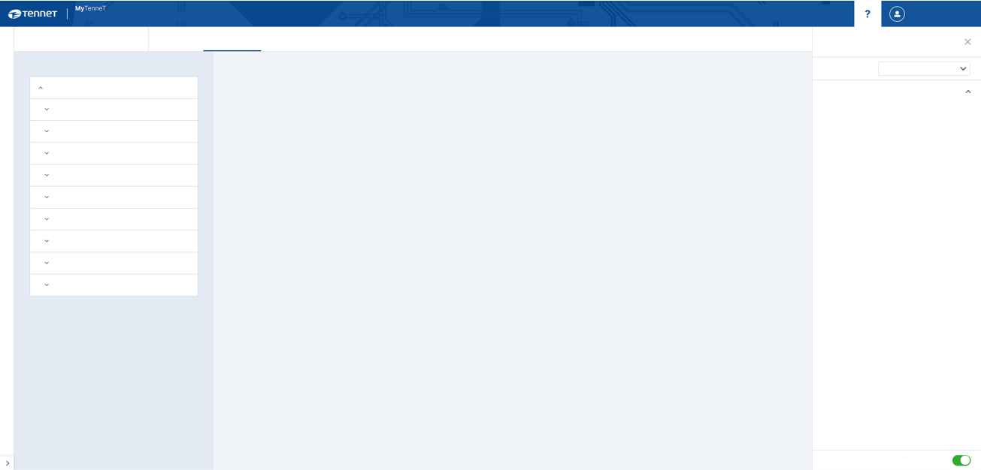
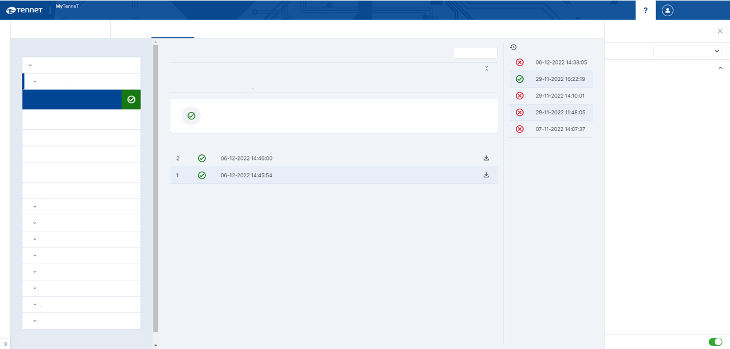
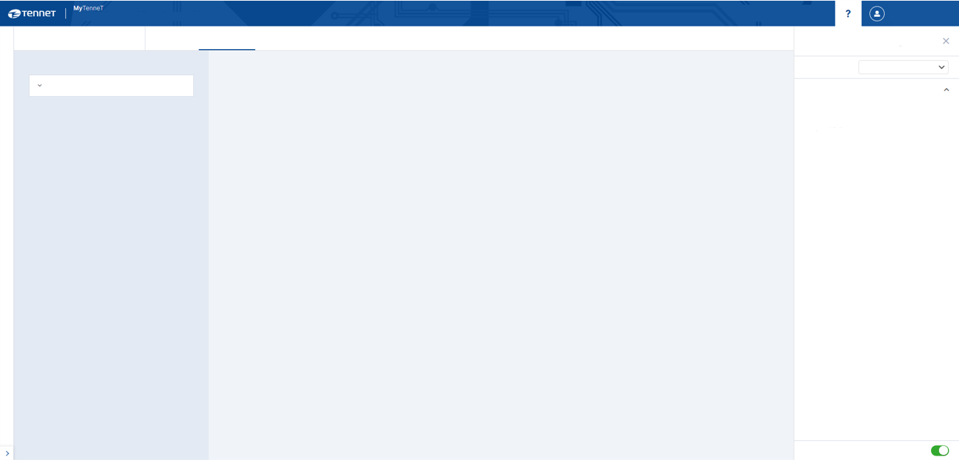
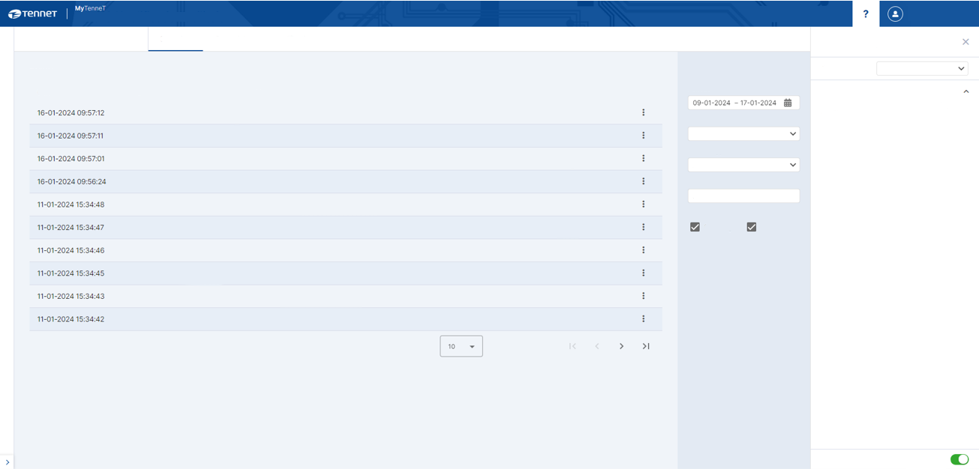
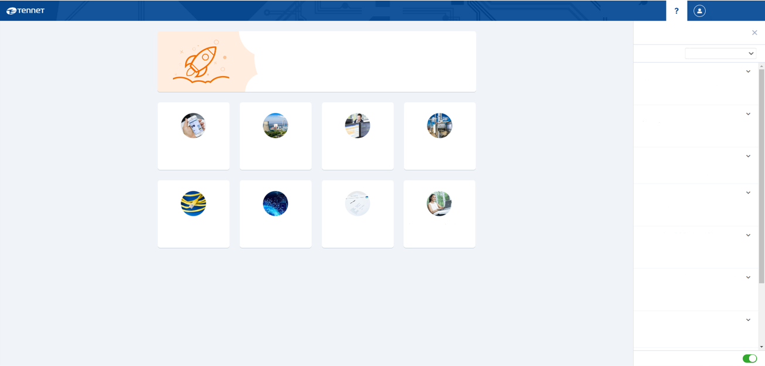
Autonomous testing using TQF app
3. Testing
Event log and scenarios
Test & Qualification Facility
MyTenneT
Test & Qualification Facility
Test & Qualification Facility
Test & Qualification Facility
Event log
Scenarios
Qualification
Event log
Scenarios
Qualification
Scenarios
Qualification
Event log
Scenarios
Qualification
Event log
Frequently asked questions
Frequently asked questions
Frequently asked questions
Frequently asked questions
Safer login MyTenneT
Frequently asked questions
Scenario history
Processes
Filters
Event log
Processes
Processes
Category
TQF
Category
TQF
TQF
Without Correlation ID in the EDSN header
Category
TQF
Category
Cyber security is given the highest priority at TenneT. That is why MyTenneT will soon be switching to a new 2-factor authentication method via the MobilePASS+ app instead of SMS. You will also soon be switching to the new authentication method. More information and instructions will follow via e-mail.
Start scenario...
Category
MyTenneT
Allocation
Allocation
Allocation
Period
Where do I find more information about the TQF?
Note
Where do I find more information about the TQF?
Where do I find more information about the TQF?
What do I need to kn ow about the Nominations app?
Date & time of receipt
Event type
Content type
Correlation ID
Where do I find more information about the TQF?
You can find the following two documents on MyTenneT in the 'IT connections' App:
The message that is sent does not have a Correlation ID in the EDSN Business Document Header. An Acknowledgement (confirmation) is expected with the correct means of correlation.
You can find the following two documents on MyTenneT in the 'IT connections' App:
You can find the following two documents on MyTenneT in the 'IT connections' App:
Acknowledgement N101
You can find the following two documents on MyTenneT in the 'IT connections' App:
Acknowledgement N101
SYNTAX_VALIDATED
VOLUME_SERIES_NOTIFICATION_N41
0ec1dbf2-603b-54c2-e063-b112350ab5aa
Event type
Once a BRP has switched to sending Nominations per XML, the...
TQF Platform Guide
TQF-FAQ
Without Correlation ID in the EDSN header
TQF Platform Guide
TQF-FAQ
TQF Platform Guide
TQF-FAQ
Acknowledgement N131
SYNTAX_VALIDATED
VOLUME_SERIES_NOTIFICATION_N41
0ec1f320-1e88-7647-e063-b112350a96ae
All
TQF Platform Guide
TQF-FAQ
Acknowledgement N141
Scenario successful
The scenario will start on 06-12-2022 14:45:54 and end on 06-12-2022 14:48:43
Content type
Which requirements must be met by the password for MyTenneT?
With Correlation ID in the EDSN header
SYNTAX_VALIDATED
MEASUREMENT_SER1ES_NOTIFICATION_N10
0f0bfff9-a955-904e-e063-b112350a4f3c
All
Acknowledgement N102
MEASUREMENT_SERIES_NOTIFICATION_N10
0f0btff9-a90c-904e-e063-b112350a4f3c
The password for MyTenneT must at least meet the following requirements:...
Message period in the future
SYNTAX_VALIDATED
News
Status
Start date and time
My organisation
Direction
System services
Nominations
Correlation ID
Acknowledgement N111
No.
Your accreditations
Content type
min. 3 characters
Can I change my password?
Your TenneT news overview
Your contacts and MyTenneT accounts
2bf78f50-6bdf-4fd3-ac15-e3a034b64ff0
Insight and status of your E-programmes
Incorrect number of positions
SYNTAX_VALIDATED
ALLOCATION_SERIES_NOTIFICATION_N101
from MP to TenneT
ACK_ALLOCATION_SERIES_NOTIFICATION_N101
You can change your password under User settings, by...
Acknowledgement N121
Missing time series for Production
SYNTAX_VALIDATED
ALLOCATION_SERIES_NOTIFICATION_N101
1d0a2875-455a-4fe0-9d86-831415167085
Successful
Failed
Select a scenario
from TenneT to MP
ALLOCATION_SERIES_NOTIFICATION_N101
Acknowledgement N132
Select a scenario
I want to access invoices but cannot find them. Where can I find them?
Negative values for Off-take
SYNTAX_VALIDATED
ALLOCATION_SERIES_NOTIFICATION_N101
61e6d917-b1bf-468c-9820-dc33eabe8d13
Acknowledgement N142
SYNTAX_VALIDATED
1399106a-731a-42df-8b25-91cdd81c7542
You require separate rights to access invoices; you can request them via...
Acknowledgement N131
ALLOCATION_SERIES_NOTIFICATION_N101
Acknowledgement N151
IT connections
TQF
Invoices
TenneT contact info
Acknowledgement N141
SYNTAX_VALIDATED
ALLOCATION_SERIES_NOTIFICATION_N101
2092ae30-0d7d -4c8d-96e1 -97e2ad267864
Info for designing IT accounts with TenneT
MMC-Hub Test- & Qualification Facility
Your invoice and invoice details overview
Your TenneT contacts
Is a user manual available for MyTenneT account managers?
Acknowledgement N102
SYNTAX.VALIDATED
ALLOCATION_SERIES_NOTIFICATION_N101
50b50ac3-dbd2-4d2d-a826-d0ba9c14a565
A user manual for MyTenneT account managers is available in the IT...
Acknowledgement N111
Events per page
1 - 10 of 261
Acknowledgement N121
Is a user manual available for the APFAS application?
Acknowledgement N132
Is a user manual for APFAS available in the IT connections app, filter by...
Acknowledgement N142
Can I change my login name?
Acknowledgement N151
Your login name is a fixed name (number) that has been generated by MyTenneT. You can...
Always show FAQ
Always show FAQ
Always show FAQ
Always show FAQ
Always show FAQ

Slide 125
Step 4: qualification
4. Qualification
The final step before go live
TenneT realisation
Onboarding and transition process
1. Prepare
  Process preparation
  Channel preparation
  Notification development
2. Connection
  Questionnaire
  Transport- & Signing Security
  Realise connection with Test & Qualification Facility (TQF)
3. Testing
  Functional testing (semantic validations)
  Test scenarios (processes)
4. Qualification
  Qualification in accordance with Net code as prerequisite for go live
5. Go live
  Realise connection with MMC-hub
  Go live
  Transfer to management
6. Operational
  Intensified surveillance
0. Publication of transition planning
0. Release of new market documentation
TenneT systems ready:
start transition
Market party is ready for onboarding
Market party has working connection with TQF
Market party has completed testing and debugging
Qualification
successful to participate in exchange of notifications
IT connection is operational and managed

Slide 126

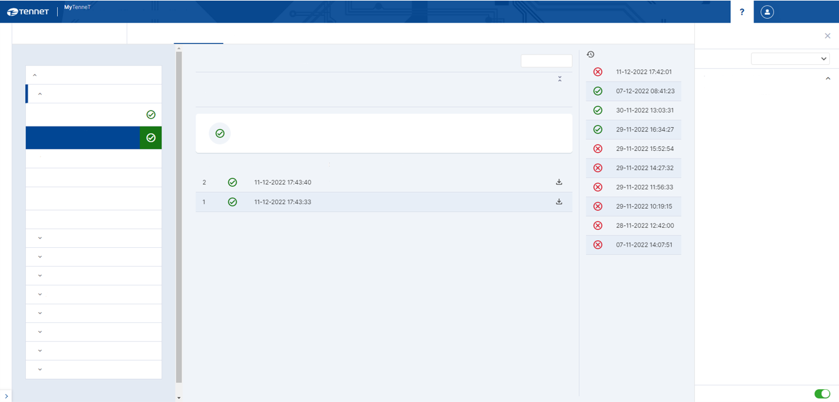
Once all green ticks have been received
4. Qualification
The Test and Qualification plan will be published at end Q1
In accordance with the Test and Qualification Plan
Test & Qualification Facility
Test & Qualification Facility
Event log
Scenarios
Qualification
Event log
Scenarios
Qualification
Frequently asked questions
Frequently asked questions
Scenario history
Processes
Scenario history
Processes
Category
TQF
With Correlation ID in the EDSN header
Category
TQF
With Correlation ID in the EDSN header
Start scenario...
Start scenario...
Allocation
Allocation
Where do I find more information about the TQF?
Note
Where do I find more information about the TQF?
Note
The message that is sent contains a Correlation ID in the EDSN Business Document Header. An Acknowledgement (confirmation) is expected with the correct means of correlation.
You can find the following two documents on MyTenneT in the 'IT connections' App:
Acknowledgement N101
The message that is sent contains a Correlation ID in the EDSN Business Document Header. An Acknowledgement (confirmation) is expected with the correct means of correlation.
You can find the following two documents on MyTenneT in the 'IT connections' App:
Acknowledgement N101
TQF Platform Guide
TQF-FAQ
Without Correlation ID in the EDSN header
TQF Platform Guide
TQF-FAQ
Without Correlation ID in the EDSN header
Scenario successful
The scenario will start on 06-12-2022 14:45:54 and end on 06-12-2022 14:48:43
With Correlation ID in the EDSN header
Scenario successful
The scenario will start on 11-12-2022 17:43:33 and end on 11-12-2022 17:44:35
With Correlation ID in the EDSN header
Message period in the future
Message period in the future
No.
Status
Start date and time
Direction
Content type
Incorrect number of positions
No.
Status
Start date and time
Direction
Content type
Incorrect number of positions
from MP to TenneT
ACK_ALLOCATION_SERIES_NOTIFICATION_N101
Missing time series for Production
from MP to TenneT
ACK_ALLOCATION_SERIES_NOTIFICATION_N101
Missing time series for Production
from TenneT to MP
ALLOCATION_SERIES_NOTIFICATION_N101
from TenneT to MP
ALLOCATION_SERIES_NOTIFICATION_N101
Negative values for Off-take
Negative values for Off-take
Acknowledgement N131
Acknowledgement N131
Acknowledgement N141
Acknowledgement N141
Acknowledgement N102
Acknowledgement N102
Acknowledgement N111
Acknowledgement N111
Acknowledgement N121
Acknowledgement N121
Acknowledgement N132
Acknowledgement N132
Acknowledgement N142
Acknowledgement N142
Acknowledgement N151
Acknowledgement N151
Always show FAQ
Always show FAQ

Slide 127

Go is issued manually
4. Qualification
Party completes qualification report
Tenner TSO B.V. 27 December 2023
14 of 14
DATE
PAGE
In principle, parties can test and qualify autonomously
Qualification will have been realised once all scenarios for which qualification is necessary have been successfully completed
Approval for this can be obtained by filling in the qualification report and sending it to TenneT
TenneT will perform checks and issue a Go for the go live
Appendix 3: Qualification report
Market party:
EAN13:
Market role: |  | (BRP, SUP, DSO, FGO, TSO)
Enter the CorrelationID (from the SOAP header) that accompanies the concerned scenario
Scenario | CorrelationID
1
2
3
4
5
0
7
3
0
10
11
12
13
14
15
16
17
18
19
20
21
22
23
24

Slide 128
Step 5: go live
5. Go live
Or in fact: technical go live
TenneT realisation
Onboarding and transition process
1. Prepare
  Process preparation
  Channel preparation
  Notification development
2. Connection
  Questionnaire
  Transport- & Signing Security
  Realise connection with Test & Qualification Facility (TQF)
3. Testing
  Functional testing (semantic validations)
  Test scenarios (processes)
4. Qualification
  Qualification in accordance with Net code as prerequisite for go live
5. Go live
  Realise connection with MMC-hub
  Go live
  Transfer to management
6. Operational
  Intensified surveillance
0. Publication of transition planning
0. Release of new market documentation
TenneT systems ready:
start transition
Market party is ready for onboarding
Market party has working connection with TQF
Market party has completed testing and debugging
Qualification
successful to participate in exchange of notifications
IT connection is operational and managed

Slide 129
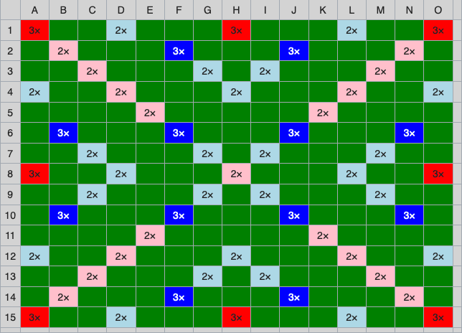
Configuration on PROD
5. Go live
Production connectivity test
Once qualification has been realised, TenneT will enable access to the MMC-hub on PROD, ready for the go live on 01-01-2025
A connectivity test still needs to be carried out on PROD (experience has shown)
The test will be successful if an acknowledgement, where the content has been rejected, is received (under send), or if the acknowledgement is returned to TenneT by the market party (under received)

Slide 130
Step 6: operational
6. Operational
Important points after go live
TenneT realisation
Onboarding and transition process
1. Prepare
  Process preparation
  Channel preparation
  Notification development
2. Connection
  Questionnaire
  Transport- & Signing Security
  Realise connection with Test & Qualification Facility (TQF)
3. Testing
  Functional testing (semantic validations)
  Test scenarios (processes)
4. Qualification
  Qualification in accordance with Net code as prerequisite for go live
5. Go live
  Realise connection with MMC-hub
  Go live
  Transfer to management
6. Operational
  Intensified surveillance
0. Publication of transition planning
0. Release of new market documentation
TenneT systems ready:
start transition
Market party is ready for onboarding
Market party has working connection with TQF
Market party has completed testing and debugging
Qualification
successful to participate in exchange of notifications
IT connection is operational and managed

Slide 131
Important points after go live
6. Operational
Qualifications will remain valid as long as the process is implemented successfully in practice
Security certificates have limited validity. The certificate owner is responsible for timely renewal. TenneT hereby facilitates communication with the other MMC-hub users (before a signing certificate is changed)
Make sure that the contact information remains up-to-date. TenneT communicates with market parties based on the ‘Contact Roles’ registered on MyTenneT (my organisation app)

Slide 132






Remain up-to-date
All relevant documents can be found on mijnMFFBAS
Updates
Updates will be placed in the SharePoint environment mijnMFFBAS
Newsletter
A regular update will be provided via the newsletter
Help desk
vragen@mffbas.nl
SharePoint
Relevant documentation can be accessed via mijnMFFBAS.
Request access, also for non-members
MijnMFFBAS

Slide 133
Acknowledgements

